Slide 1
Fresh Grads – Group Project
Online Ayurveda Medicine Order App
Group 4:
Anand Joshi
Vamsi Kishore
Vasudeva Reddy
Bishal Aditya

Slide 2
Problem Statement
To Create an Application for Online Ayurveda Medicine
Customer should be able to search,buy, modify and order the medicine.
Admin should be able to perform below operations:
1.Customer Management
2.Medicine Management
3.Order Management

Slide 3
Road Map
Application will be developed in following Sprints –
Core Java +JPA with Hibernate
Spring Boot + Rest Controller + JPA with Hibernate
Angular for UI design (Front End) + Integration with previous Sprint

Slide 4





Technologies used

Slide 5
Modules
Login Module
Customer Module
Order Module
Medicine Module
Category
Module
Cart Module

Slide 6
Use Cases
Actor- Admin
View user
Add user
Update user
View customer
Add or remove customer
Add medicines to the inventory
Remove medicine from the inventory
View medicines from the inventory
All medicines
By id
By company
By category
Update medicine information
View orders
Edit the order detail
Actor- Customer
View Details
Edit Details
View Medicines- All medicines
By name
By category
Add medicines to the cart
Remove medicine from the cart
Show medicines present in the cart
Order the medicine present in the cart
View orders
Track orders(order status, dispatch date, total cost, ordered medicines)

Slide 7
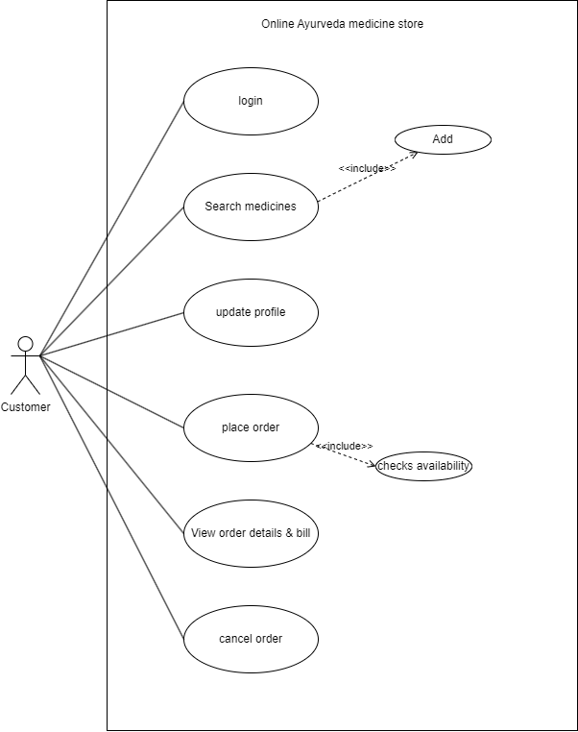
Use-Case Diagram

Slide 8
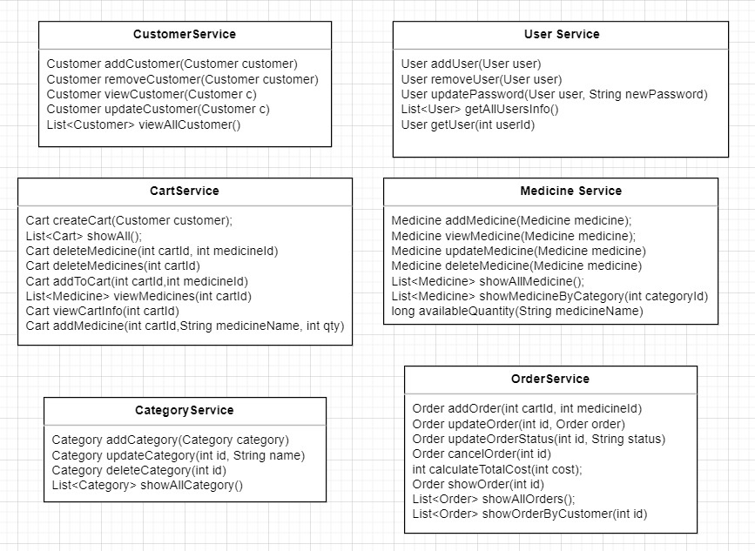
Class Design
Service:

Slide 9
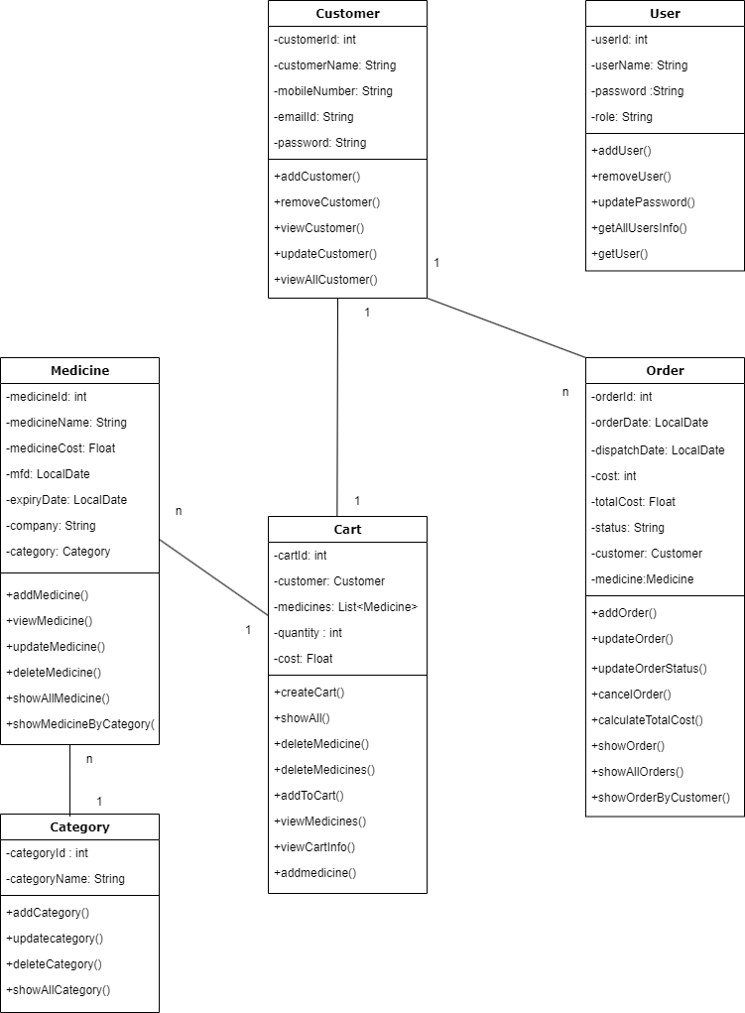
Class Design

Slide 10
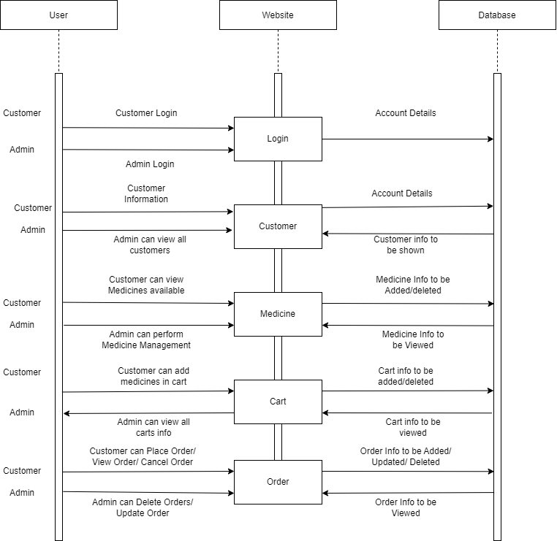
Sequence Diagram

Slide 11
Plan to execute case study
Understanding requirements
Backend Implementation
Frontend Implementation
Use Case diagram, ER diagram, Class diagram, Sequence diagram
Module wise division of work

Slide 12
Conclusion
Thus we were able to implement the case study of online Aayurveda app and in the process learned
Java
Spring Boot
HTML
CSS (Bootstrap)
Javascript
React
and used them to implement a solution to the given problem.

